Slide 1
Content management project for Speedo Tours
Made by:
Nour Eldeen Mohamed
Khaled Nader Elgammal
Ramez Nabil Fahmy
Ahmed Mohamed Salah Mahdy
Supervised By: Dr.Essam Eliwa

Slide 2
Revised Problem Statement.
The main problem the web application was created for improving was that the company didn’t use any software in order to keep track of their data , the whole sequence was made manually. Also the booking of a hotel or a package was made manually by contacting the company in order to view current offers and book a hotel or a package through them.

Slide 3
System Overview
The client is able to preform couple of things like booking , reviewing a hotel or a package. Also the user is able to send an inquiry to the support center about a specific hotel or a package.
The support operator is able to reply to inquires of guests and send the latest news to subscribed guests.
The admin is able to add hotels , packages or edit the main page content and about us page content. Also the admin is able to confirm a reservation of a guest or deny the reservation.

Slide 4
Architectural design:

Slide 5
Logical Viewpoint

Slide 6
Patterns use viewpoint

Slide 7
Structure Viewpoint

Slide 8
Interaction viewpoint

Slide 9
Database Design

Slide 10
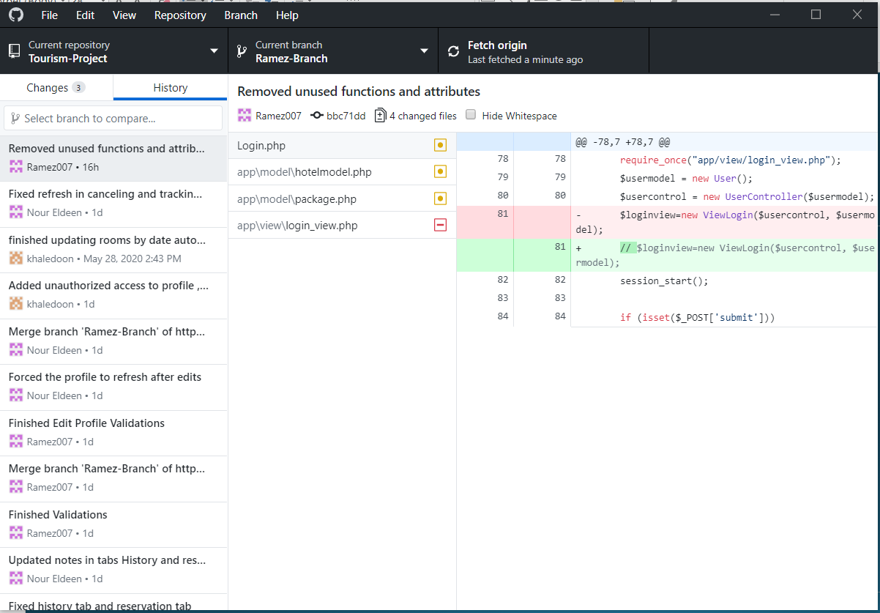
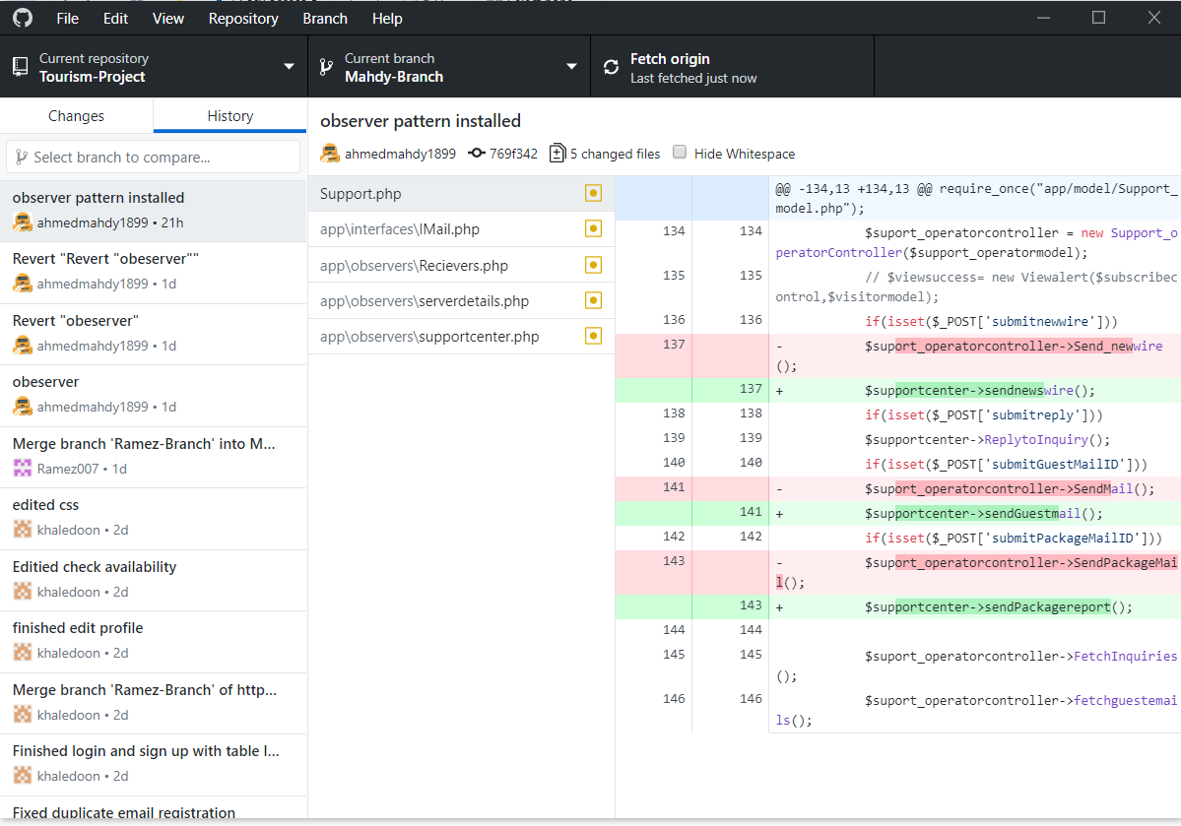
GitHub
Link : https://github.com/Ramez007/Tourism-Project
Images:

